Slide 1
Chess Playing Robotic Arm
The future of Chess…

Slide 2
Table of Contents
1
3
2
4
Introduction
Tips
Here you could describe
the topic of the section
Here you could describe
the topic of the section
Features of the Topic
Practical Exercise
Here you could describe
the topic of the section
Here you could describe
the topic of the section
Notes:
~ About Chess
~ Automation
~ Chess Playing Robot
First input from the player is given whether he wants black or white. If the player chooses white then Robotic arm takes black color and black color is given as input and vice versa if players chooses black suppose player chooses white here
Game starts. As soon as the game begins, image processing starts to check if white played the move. The detection of movement is detected by simple subtraction of two images first one is original image and second is the new image formed to changes of position of pieces on board. If subtraction results in nothing that means no move is played. If subtraction results in a non zero matrix then move is played by white. This lets Robot understand if move is played or not.
Suppose white plays move E4 here. Move is detected by image processing. Then robot fetches the move from its chess opening dictionary I created and then plays the move accordingly. The dictionary is like { “e5”:coordinates }. From this the Robot gets the desired coordinates and then by Inverse Kinematics picks up the pawn from e7 square and places it at e5 square. This is how picking and placing of piece works.
This whole process keeps on repeating itself unless game comes to conclusion. The whole Robot is controlled by Arduino pro mini which controls and provides necessary PWM to Motors.
The target au- dience was players who wished to
1. play against each other re- motely or who have
2. physical disabilities.

Slide 3
1
Introduction
You can enter a subtitle here if you need it

Slide 4
About Chess
Strategy Game
The Potential
Two player
8x8 grid
Checkmate opponent’s King
121 million moves (after 3 turns)
600–700 million players
In 2020, 45 countries participated Online Chess Olympiad for People with Disabilities

Slide 5
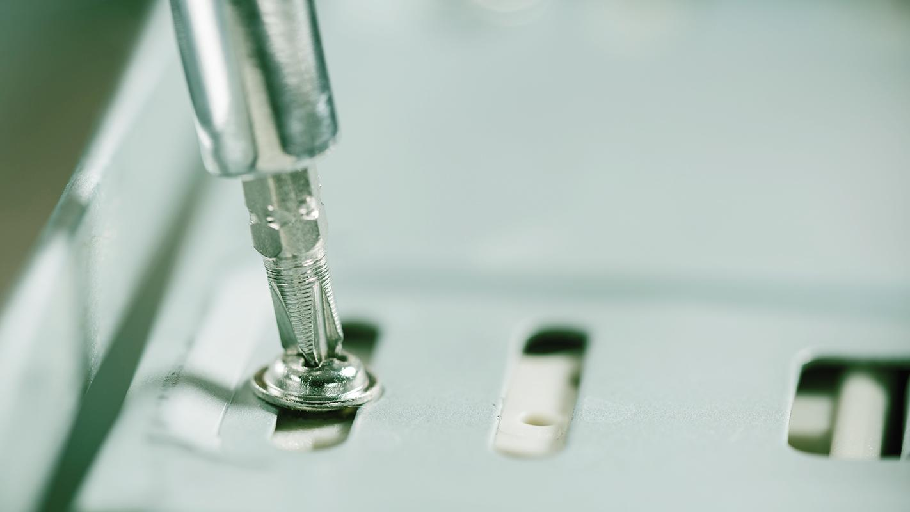
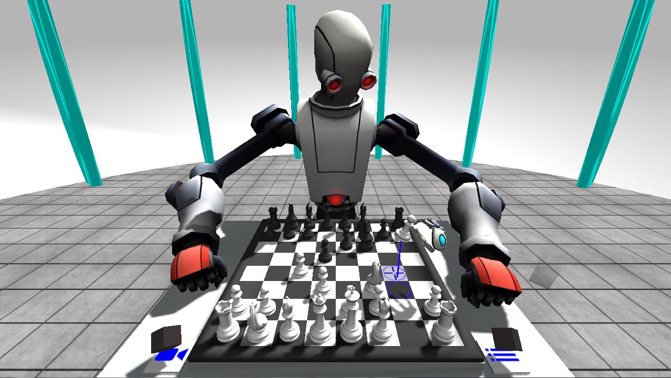
Automation Engineered to win…

Slide 6
Working
Choose Colour
Decide own move
White / Black
Alpha-beta pruning
Process opponent’s move
Execute Move
Inverse Kinematics
Image Processing

Slide 7
Kinematics of Robot
Forward Kinematics
Inverse Kinematics
Mercury is the closest planet from the Sun and the smallest one
Venus has a beautiful name and is the second planet from the Sun

Slide 8
2
Forward Kinematics
You can enter a subtitle here if you need it

Slide 9
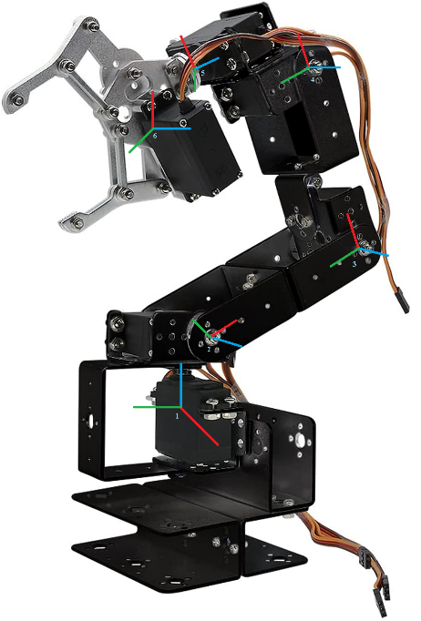
Forward Kinematics
Axes Assignment
X-axis
Y-axis
Z-axis

Slide 10
Forward Kinematics
DH Table
S# | α_{i-1} | a_{i-1} | d_{i} | θ_{i}
1 | 0 | 0 | 0 | θ₁
2 | 90 | L₁ | 0 | θ₂
3 | 0 | L₂ | 0 | θ₃
4 | 0 | L­₃ | 0 | θ­₄
5 | 90 | L­₄ | d₁ | θ₅
6 | -90 | L­₅ | 0 | 0

Slide 11
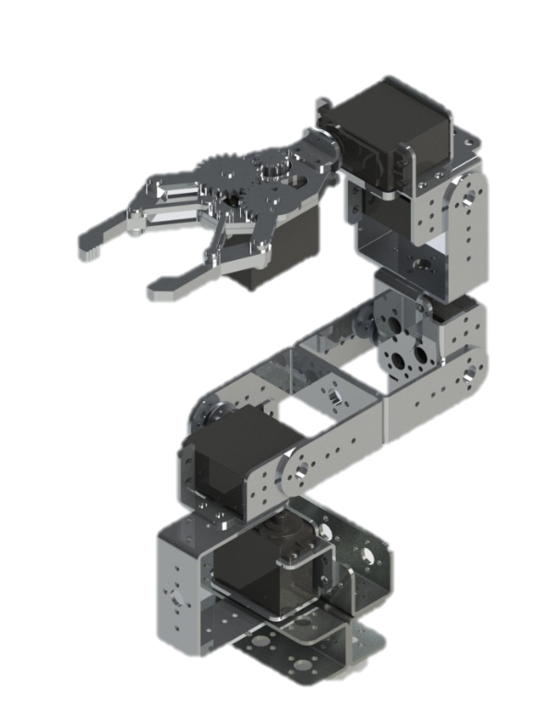
Forward Kinematics
Link Lengths & CAD Assembly
Link Length | Length (mm)
L₁ | 31
L₂ | 103
L₃ | 103
L₄ | 28
L₅ | 7
d₅ | 64

Slide 12
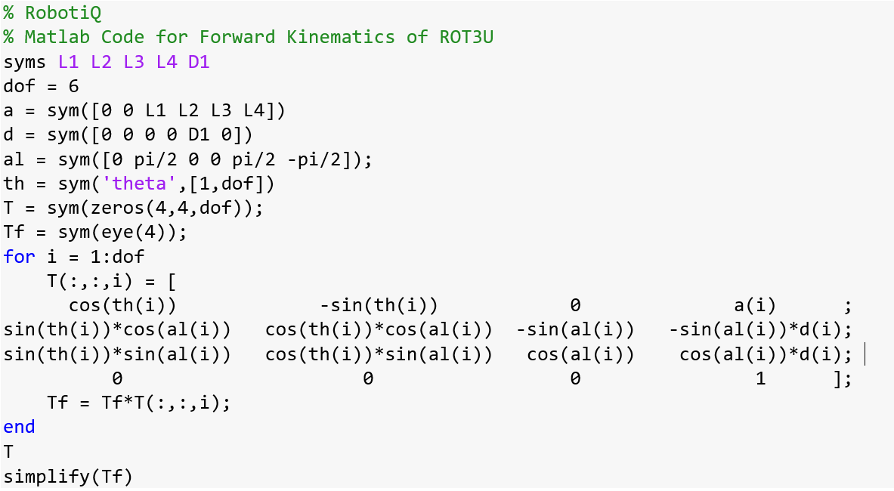
Forward Kinematics
MATLAB Code

Slide 13
3
Inverse Kinematics

Slide 14
Improvements
1
2
Link Lengths
Offset

Slide 15
Inverse Kinematics
Numerical Method
Analytical Method
Jacobian Pseudoinverse
Geometric - Algebraic

Slide 16
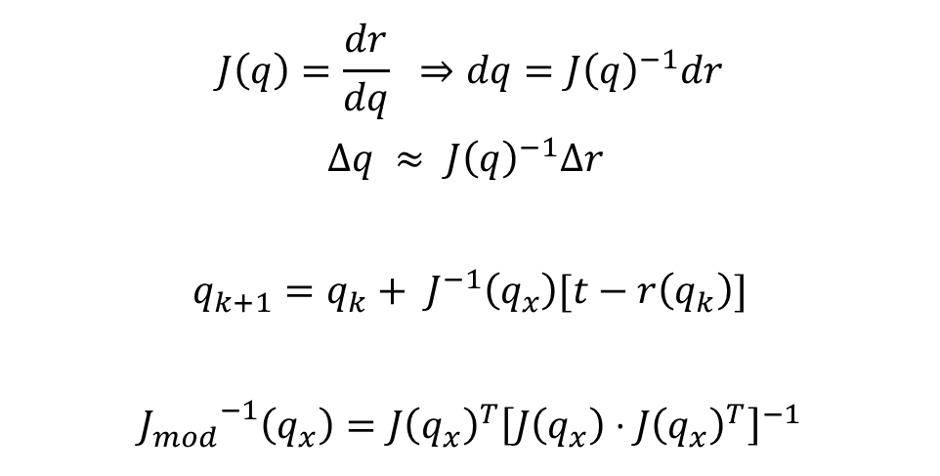
Jacobian Pseudoinverse
$$J\left(q\right)=\frac{dr}{dq} ⇒dq={J\left(q\right)}^{−1}dr$$
$$∆q ≈ {J\left(q\right)}^{−1}∆r$$
$$q_{k+1}=q_{k}+ J^{−1}\left(q_{x}\right)[t−r\left(q_{k}\right)]$$
$${J_{mod}}^{−1}\left(q_{x}\right)={J\left(q_{x}\right)}^{T}{\left[J\left(q_{x}\right)⋅{J\left(q_{x}\right)}^{T}\right]}^{−1}$$

Slide 17
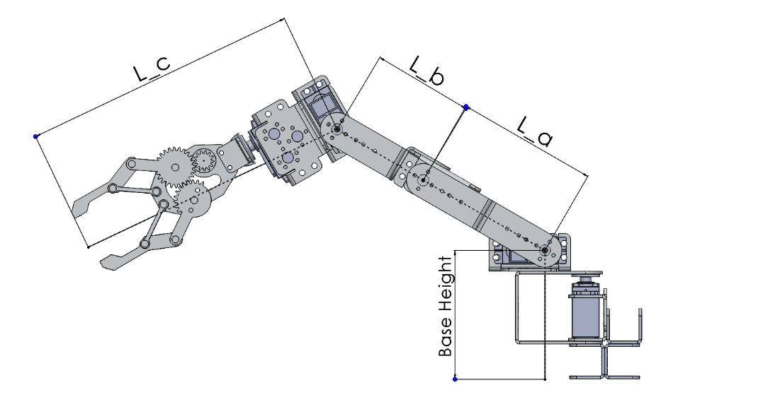
Analytical Method

Slide 18
4
Arduino

Slide 19
Improvements
1
2
3
Numerical Method
Algebraicaly
Shift to Analytical for Arduino
Jacobian proper compute
Moved from 3 to 4 joint angles

Slide 20
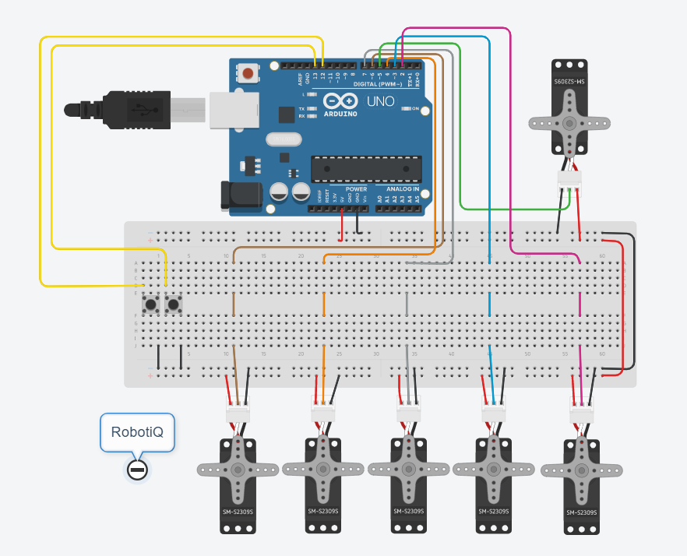
TinkerCAD Model

Slide 21
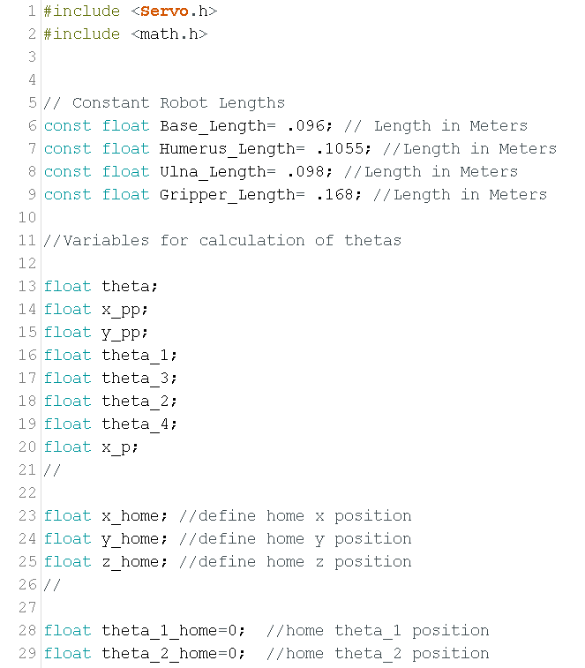
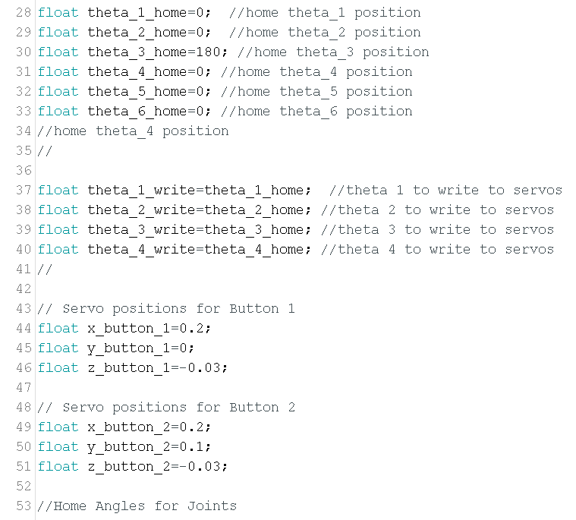
Arduino Code

Slide 22
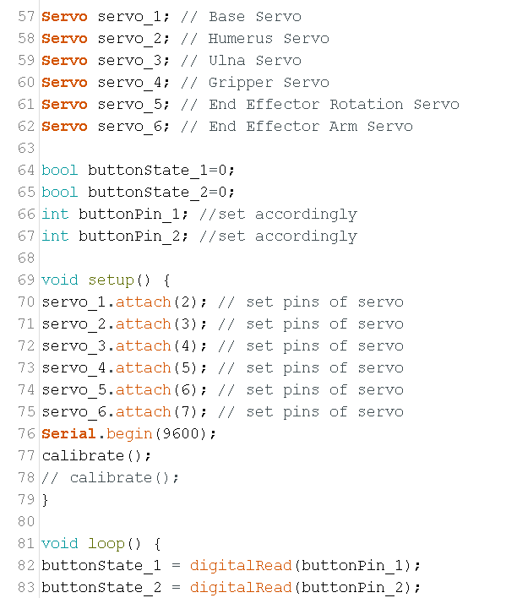
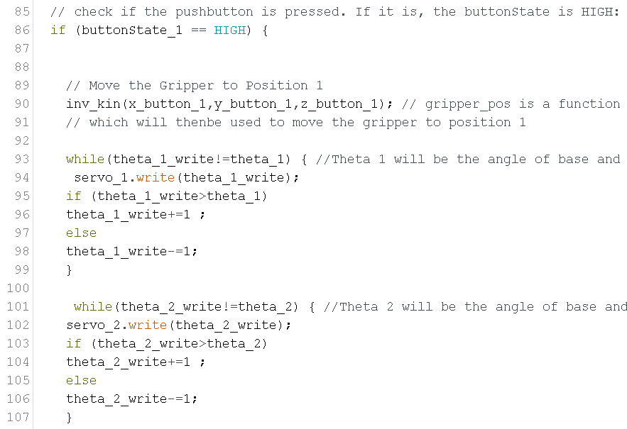
Arduino Code (Cont.)

Slide 23

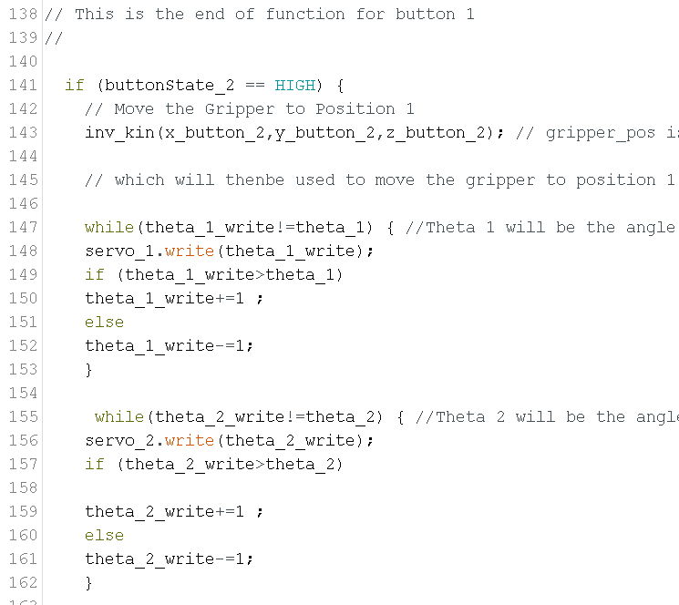
Arduino Code (Cont.)

Slide 24
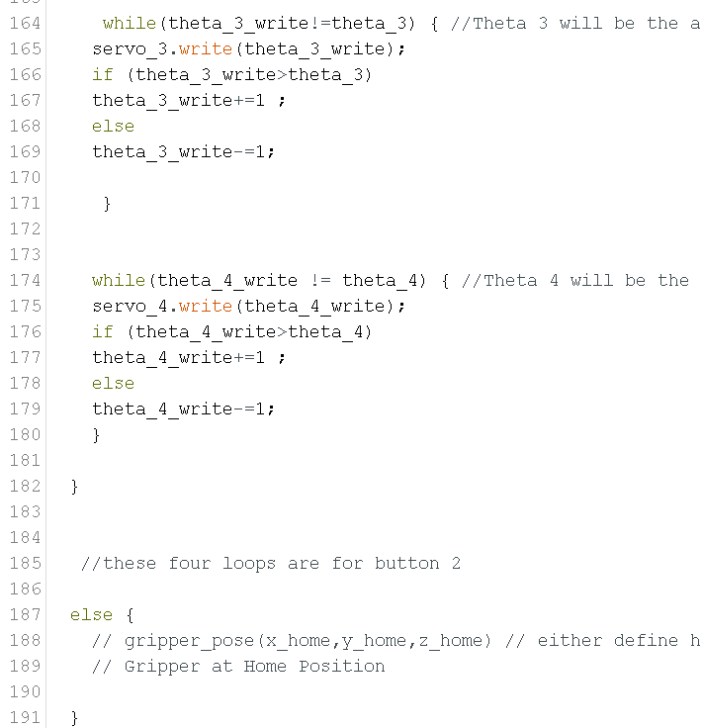
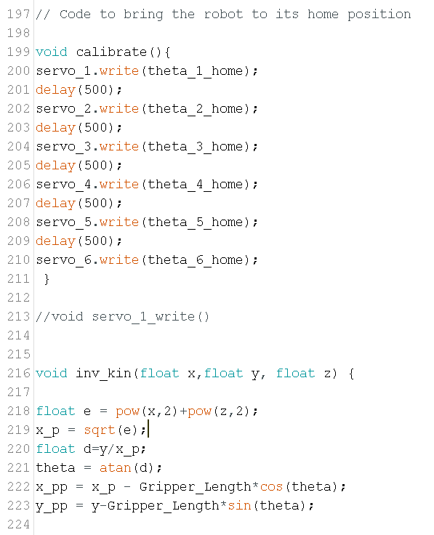
Arduino Code (Cont.)

Slide 25
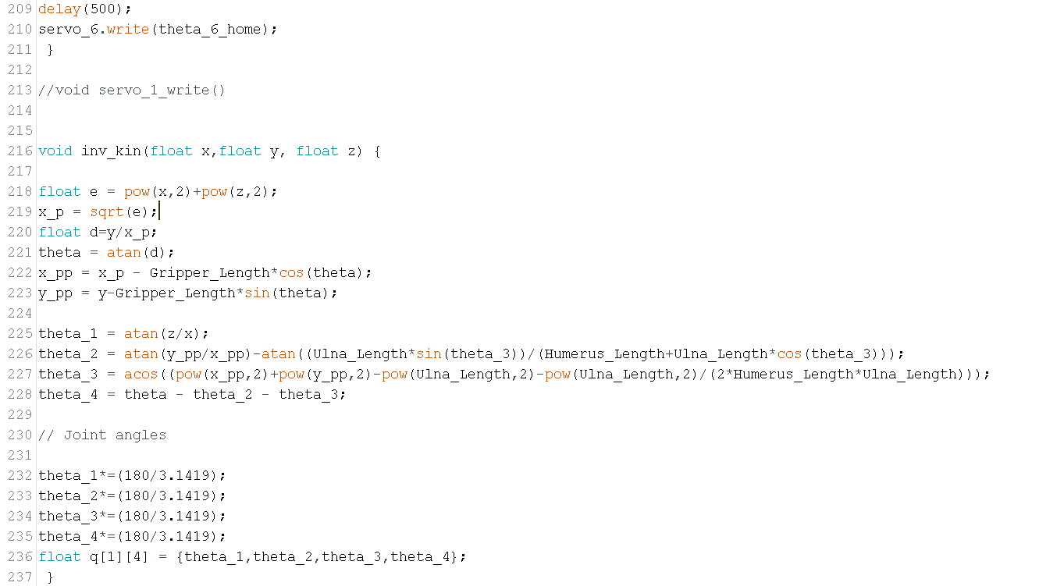
Arduino Code (Cont.)

Slide 26
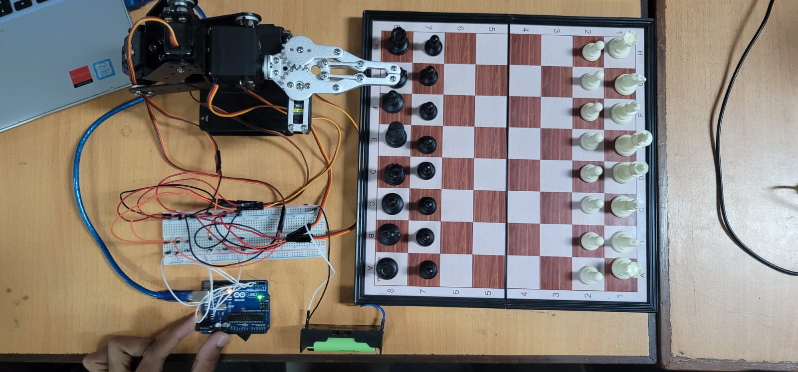
Real Circuit

Slide 27
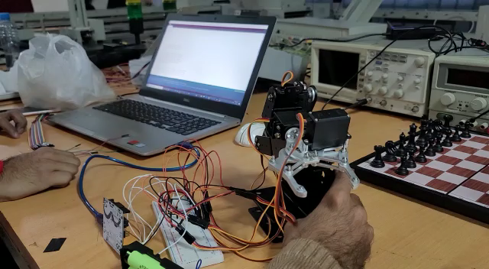
Calibration

Slide 28
Future Scope
Calibration of Workspace
Image
Processing
Machine Learning for deciding moves
Remotely Controllable

Slide 29
Thanks!
Do you have any questions?

